Slide 1
ImmGen ATACseq

Slide 2

Overview
Assessing chromatin structure
ATAC-Seq
Data collected for ImmGen
Initial Analyses
Data access
Caleb Lareau (Buenrostro lab)
Hide Yoshida (CBDM lab)
Sara Mostafavi

Slide 3
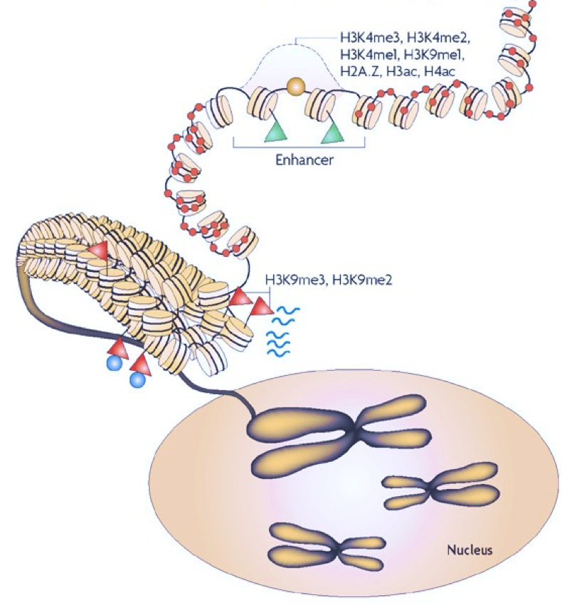
Schones et al. Nat. Rev. Genetics (2008)

Slide 4
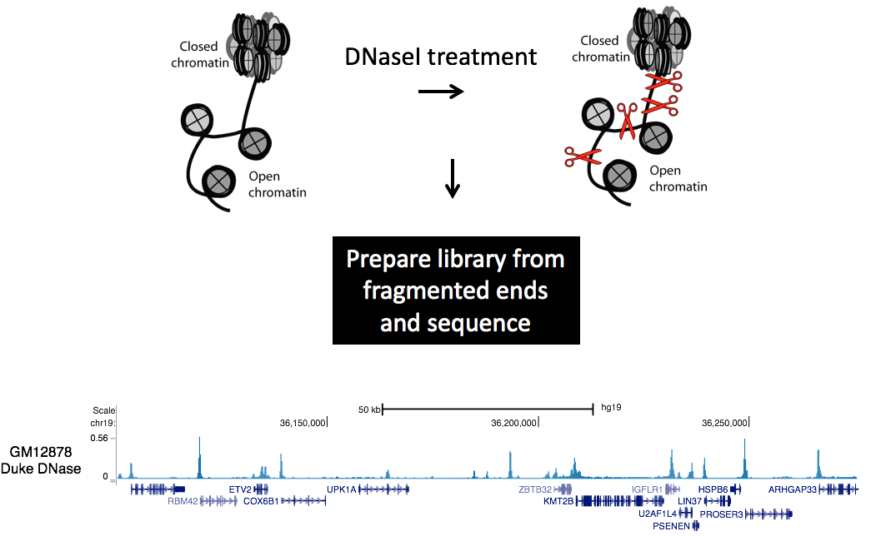
Weintraub et al. Science (1971)

Slide 5
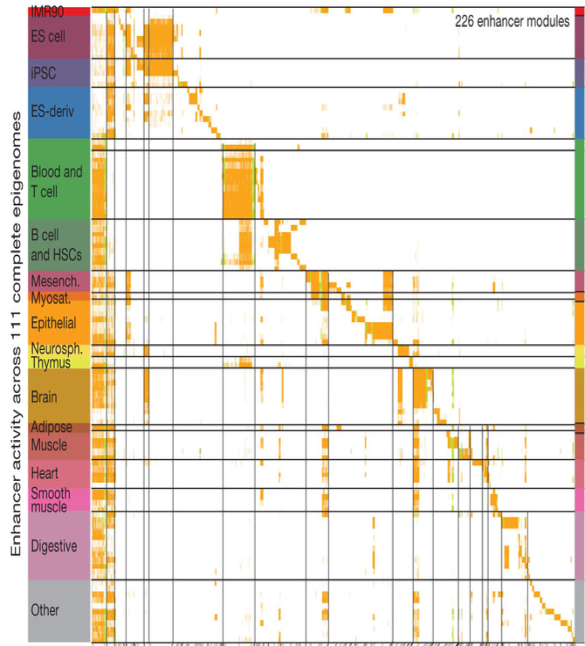
Roadmap Epigenomics Consortium. Nature (2015)

Slide 6
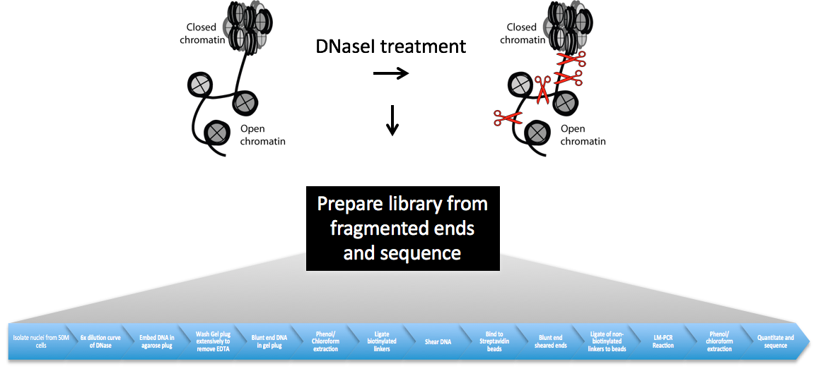
44 steps in total; requires 300+ million cells
Song and Crawford, CSH protocols 2010

Slide 7
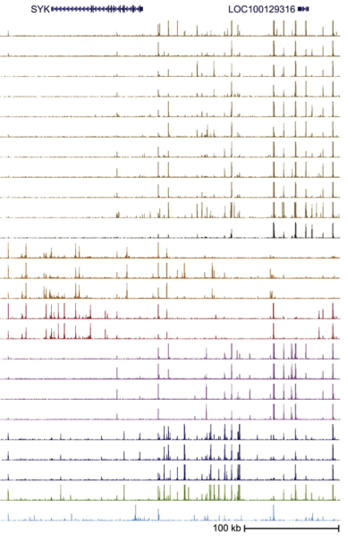




Problem: averaging over cellular diversity
Prepare
libraries
Stergachis et al. Cell (2013)

Slide 8
Better way to profile open chromatin?

Slide 9
A solution
Tn5 transposon can cut-and-paste sequencing adapters into DNA
Highly efficient platform for library preparation
Reported to insert into active regulatory regions in-vivo
9 bps
DNA path
Adapted from
Davies et al. Science 2000

Slide 10
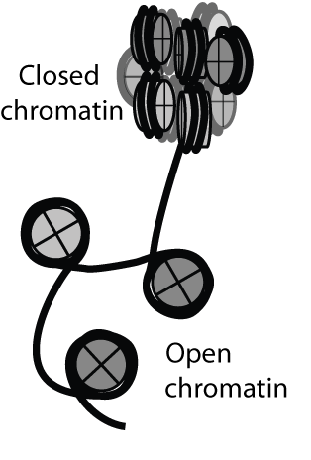
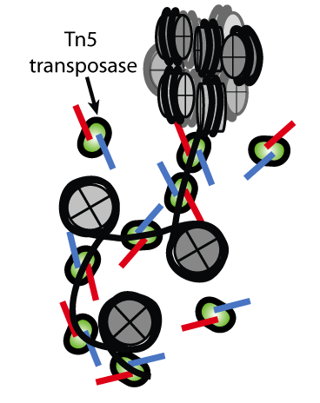
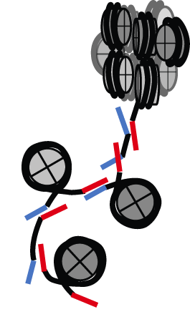
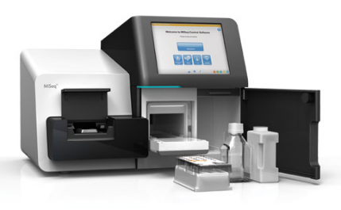
Amplify and Sequence
50,000,000 cells
50,000 cells
Buenrostro et al. Nature Methods (2013)
Buenrostro et al. Curr. Protoc. Mol. Biol. (2015)
Buenrostro et al. Nature (2015)

Slide 11
ImmGen Data

Slide 12
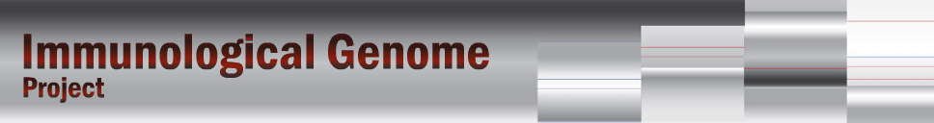
ImmGen ATAC-seq
Cell populations for ATAC-seq
12 ImmGen labs (you’ll recognize your cells…)
HSC
T
gdT
ILC
B
Mo.MF
DC
Stroma
LTHSC.34-.BM | preT.DN1.Th | Tgd.g1.1+d1.24a+.Th | ILC2.SI | proB.FrA.BM | MF.226+II+480lo.PC | DC.103+11b-.SI | FRC.CD140a+.Madcam-.CD35-.SLN
LTHSC.34+.BM | preT.DN2a.Th | Tgd.g1.1+d1.LN | ILC3.CCR6+.SI | proB.FrBC.BM | MF.Alv.Lu | DC.103+11b+.SI | BEC.SLN
MMP3.48+.BM | preT.DN2b.Th | Tgd.g2+d1.24a+.Th | ILC3.NKp46+.SI | preB.FrD.BM | MF.Fem.PC | DC.4+.Sp | Ep.MEChi.Th
MMP4.135+.BM | preT.DN3.Th | Tgd.g2+d1.LN | ILC3.NKp46–CCR6–.SI | proB.CLP.BM | MF.ICAM+480hi.PC | DC.8+.Sp | IAP.SLN
STHSC.150-.BM | T.4.Nve.Fem.Sp | Tgd.g2+d17.24a+.Th |  | B.Fo.Sp | MF.microglia.CNS | DC.pDC.Sp | LEC.SLN
 | T.4.Nve.Sp | Tgd.g2+d17.LN | GN.BM | B.FrE.BM | MF.microglia.Csf1KO.CNS
 | T.4.Sp.aCD3+CD40.18hr | Tgd.Sp | GN.Sp | B.GC.CB.Sp | MF.microglia.Csf1WT.CNS
 | T.4.Th |  | GN.Thio.PC | B.GC.CC.Sp | MF.microglia.IL34KO.CNS
 | T.8.Nve.Sp | NK.27+11b-.BM |  | B.mem.Sp | MF.microglia.IL34WT.CNS
 | T.8.Th | NK.27+11b-.Sp |  | B.MZ.Sp | MF.PC
 | T.DN4.Th | NK.27+11b+.BM |  | B.PB.Sp | MF.pIC.Alv.Lu
 | T.DP.Th | NK.27+11b+.Sp |  | B.PC.BM | MF.RP.Sp | MC.heparinase.PC
 | T.ISP.Th | NK.27-11b+.BM |  | B.PC.Sp | MF.SI.LP | MC.Sk
 | T8.IEL.LCMV.d7.Gut | NK.27-11b+.Sp |  | B.Sp | Mo.6C+II-.Bl | MC.To
 | T8.MP.LCMV.d7.Sp |  |  | B.T1.Sp | Mo.6C-II-.Bl
 | T8.Tcm.LCMV.d180.Sp | NKT.Sp |  | B.T2.Sp
 | T8.TE.LCMV.d7.Sp | NKT.Sp.LPS.18hr |  | B.T3.Sp
 | T8.Tem.LCMV.d180.Sp | NKT.Sp.LPS.3d |  | B1b.PC
 | T8.TN.P14.Sp | NKT.Sp.LPS.3hr |  | B.Fem.Sp
 | Treg.4.25hi.Sp
 | Treg.4.FP3+.Nrplo.Co
GN
NK
MC
NKT
Total 97 populations planned

Slide 13
Total 3.5B (7.0B) reads → 1.6B (3.2B) good mapped reads for 199 samples
90 populations
Passed QC
#mapped reads (removed duplicated reads)

Slide 14
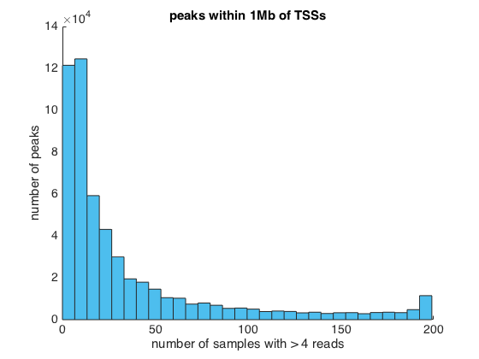
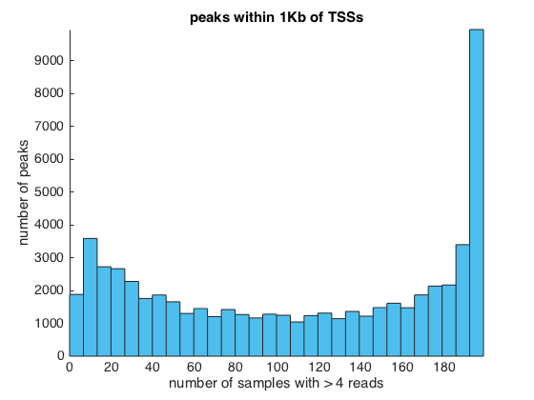
Data and statistics:
548,439 enhancer/promoter peaks across 199 samples
60K peaks within 1Kb of any TSS
168K peaks within 10Kb of any TSS
450K peaks within 100Kb of any TSS
547,364 peaks within 1Mb of any TSS
Sample specific?
All peaks (<1Mb)
Promoter peaks (<1Kb TSS)
Sample specific
common
Number of peaks
0
100
200
0
100
200
Number of samples
Number of samples
SM

Slide 15
Analysis ?
Analysis by all:
As data structures (genome maps, enhancer tables, TF tables, etc) become available, analyze in relation to immunologic context. Jamboree ??
Analysis by “Computational Analysis Working Group” (CAWG: Caleb, Sara, Jason, Hide, Tal, Bingfei?, others?)
Sample clustering by TSS vs distant ATAC peaks -- How can we discriminate immune cell populations by ATAC?
“cis-questions” —assignment of peaks to target gene
How can we map ATAC peak to gene expression? Correlations?
“trans-questions” —assignment of TFs/motifs to peaks
using motif to predict TF binding events : footprint analyses : TF to cell maps
Splicing – Can differential peaks explain differential splicing (Tal)
Regulatory network refinement
Integration with other data (Single Cell RNASeq, ChipSeq)

Slide 16
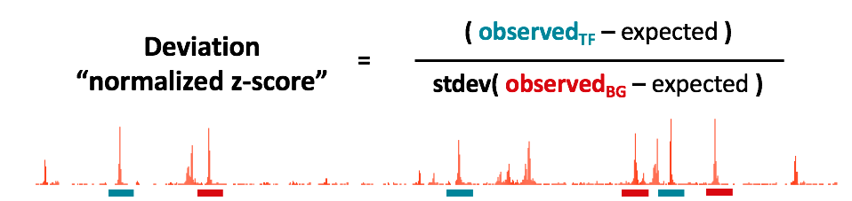
Choose set of peaks with feature (e.g. TF binding)
Sum reads across annotation (observed_{TF} – expected)
Sample a matched set of background peaks
Matched for intensity and insertion bias
Sum across background: (observed_{BG} – expected)
Buenrostro et al. Nature (2015)

Slide 17
Cavalli, G., & Misteli,T. Nature Structural Biology (2013)

Slide 18
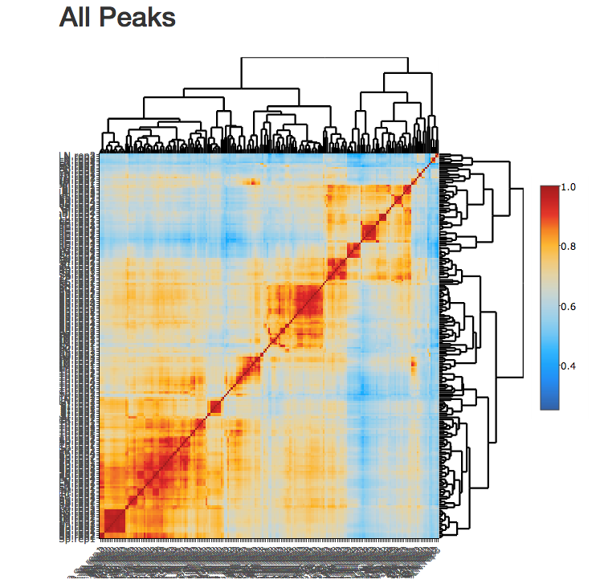
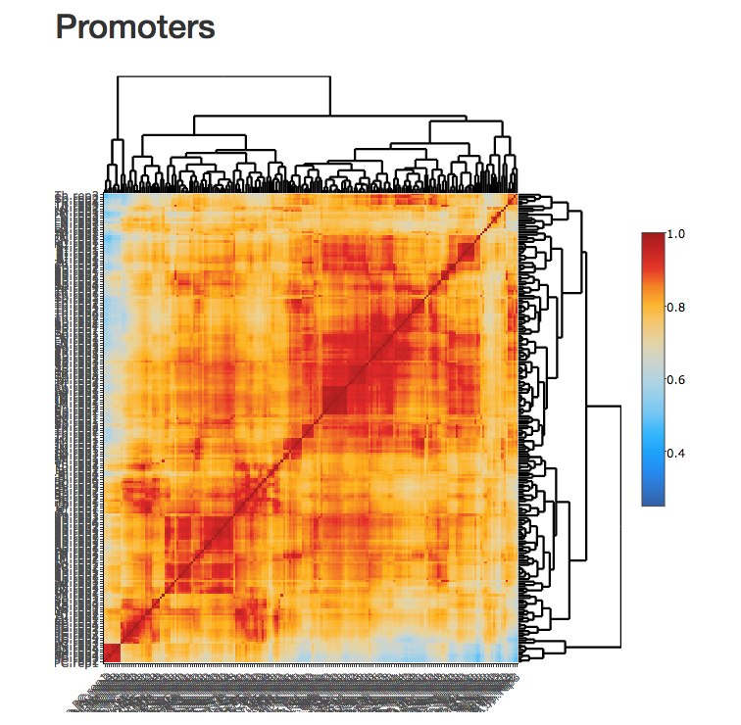
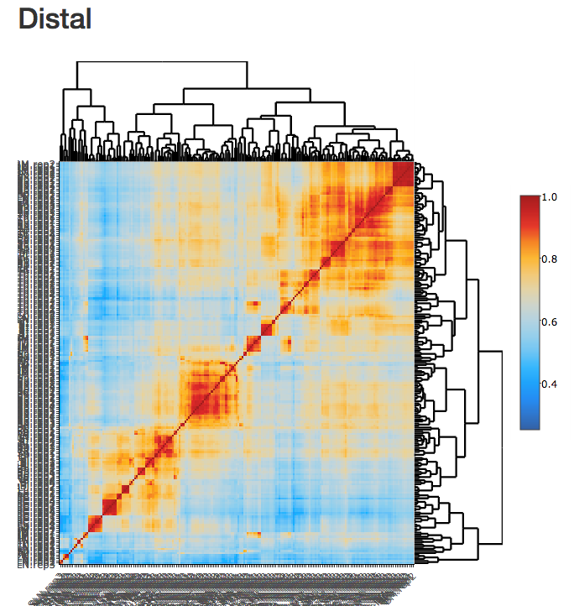
Sample-Sample Correlations

Slide 19
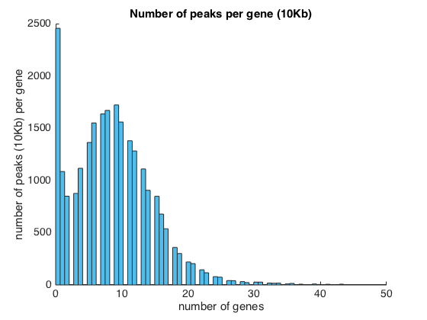
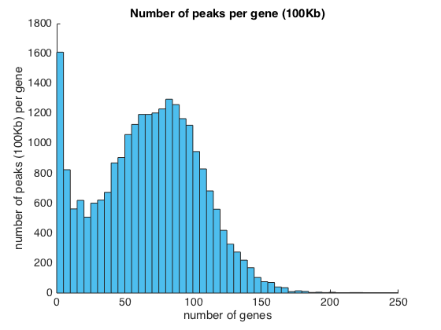
mapping ATAC to gene expression
Historical: based on linear distance from TSS
60199 peaks are within 1Kb of at least 1 TSS – 18K genes covered
~10% are within 1Kb of > 1 TSSs
168417 peaks are within 10Kb of at least 1 TSS – 22K genes covered
~20% are within 10Kb of > 1 TSSs
459970 peaks are within 100Kb of at least 1 TSS – 24K genes covered
~50% are within 100Kb of > 2 TSSs, 25% > 4 TSSs
Number of genes / peak
<10Kb
<100Kb
Number of peaks
0
20
40
0
100
200
Number of genes
Number of genes
Assignment based “TSS” or promoter peaks is too limiting (<10% of peaks accounted for)
Expanding the cis window blindly is likely to introduce too many false positive assignments
SM

Slide 20
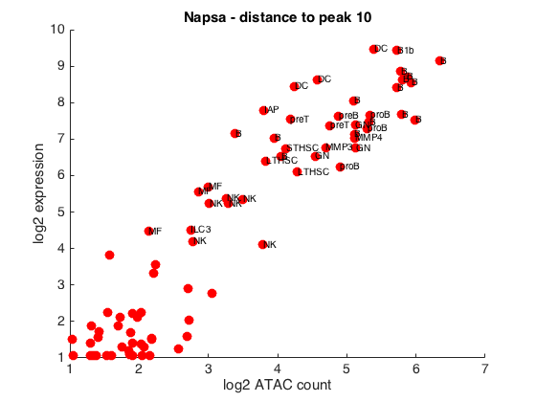
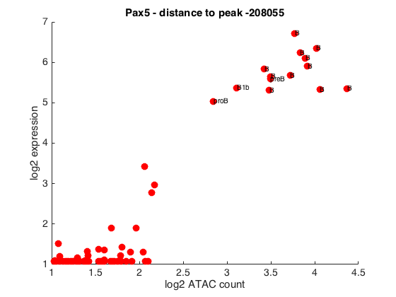
mapping ATAC to gene expression
ImmGen: based on “co-activity”
Correlation between expression and ATAC intensity across > 80 cell types
“Near” and “far” peak examples for co-activity of expression and ATAC intensity across cell types
“far” (208Kb from Pax5)
“near” (10bp from Napsa)
Gene expression
Assessing correlation between ATAC intensity and RNA expression enables refined assignments of peaks to genes
SM

Slide 21
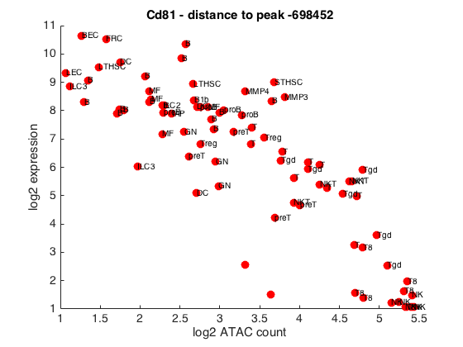
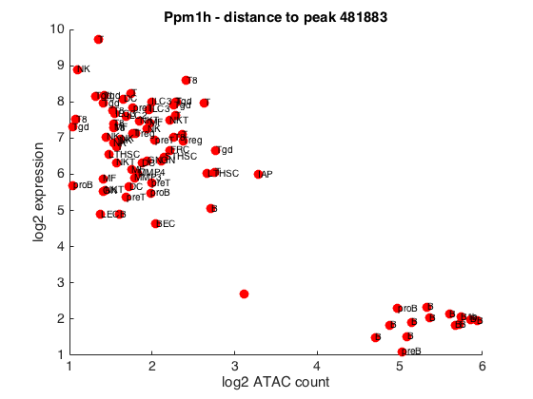
mapping ATAC to gene expression
Also some negative associations …
Interesting: only a small number of peaks are repressing transcriptional activity
698Kb from Cd81
482Kb from Ppm1h
Gene expression
SM

Slide 22
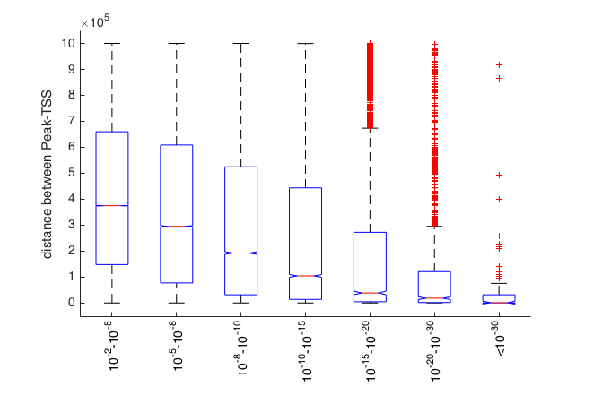
mapping ATAC to gene expression
What’s the relationship between distance to TSS and peak/RNA co-activity?
Expected (?): Closer peaks are more strongly associated with RNA expression across cells
Pvalue bin
SM

Slide 23
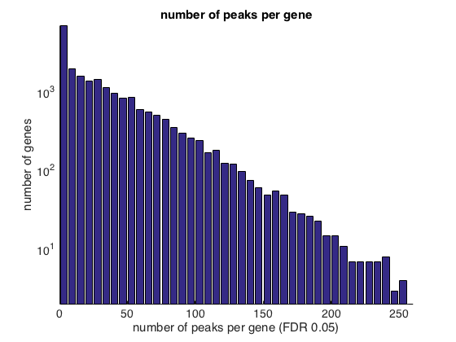
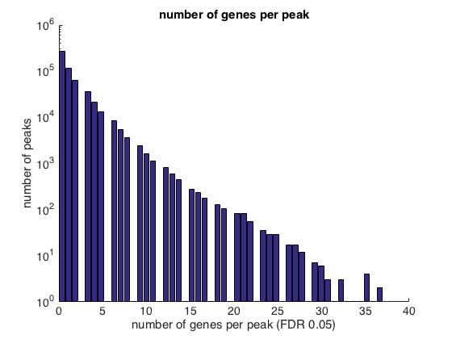
mapping ATAC to gene expression
ImmGen: based on “co-activity”
Correlation between expression and ATAC intensity across > 80 cell types
Bonferroni significant associations: 38921 total – 5919 genes & 29397 peaks
FDR 5%: 704478 total – 19789 genes & 275494 peaks
We can assign ~70% of peaks to genes based on co-activity (at 5% FDR)
Are these SEs? (note no huge SEs)
SM

Slide 24
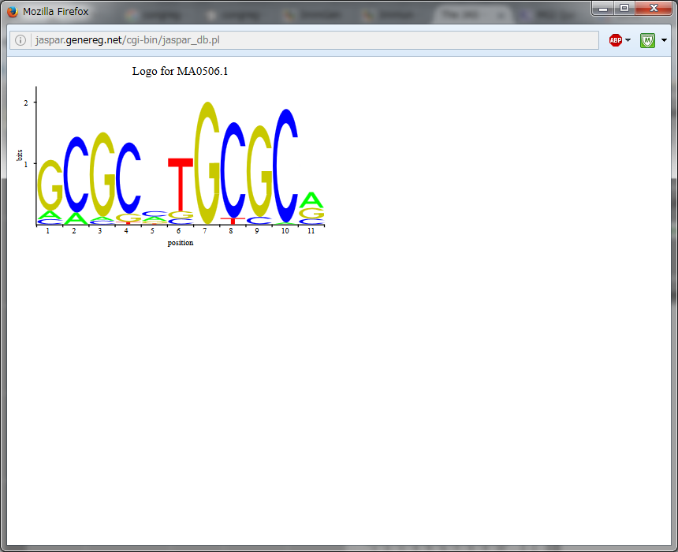
“trans-questions” —assignment of TFs/motifs to peaks
DNA-motif in peaks
PWM
ATAC-seq track
Calculate motif score by sequence similarity (“candidate” for TF binding sites)
Motif score
Footprint
predict TF binding events

Slide 25
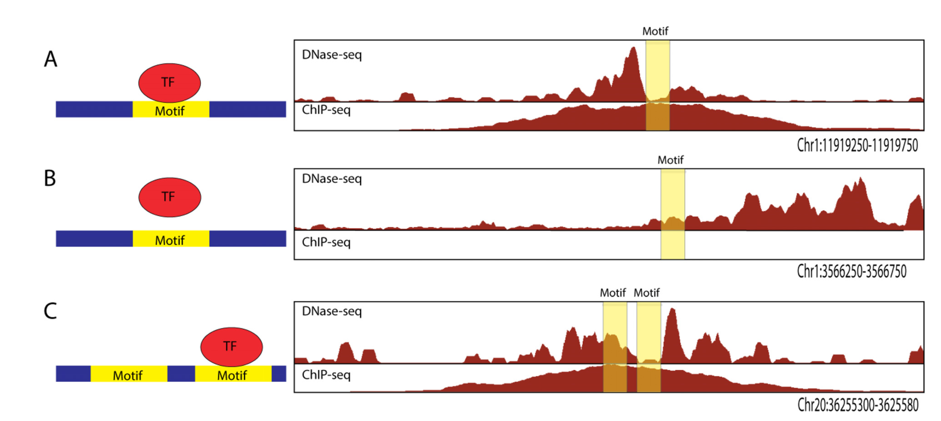
“trans-questions” —assignment of TFs/motifs to peaks
What’s foot-printing(FT)?
footprint likelihood ratio (FLR = footprint quality score),
significantly higher in cells where the TF in question is expressed
Galip Gurkan Yardımcı et al. 2014

Slide 26
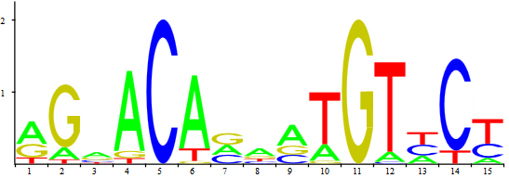
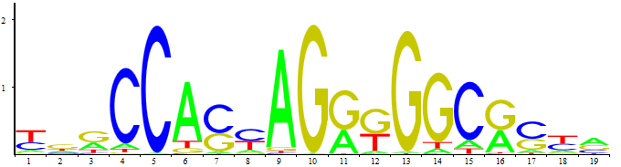
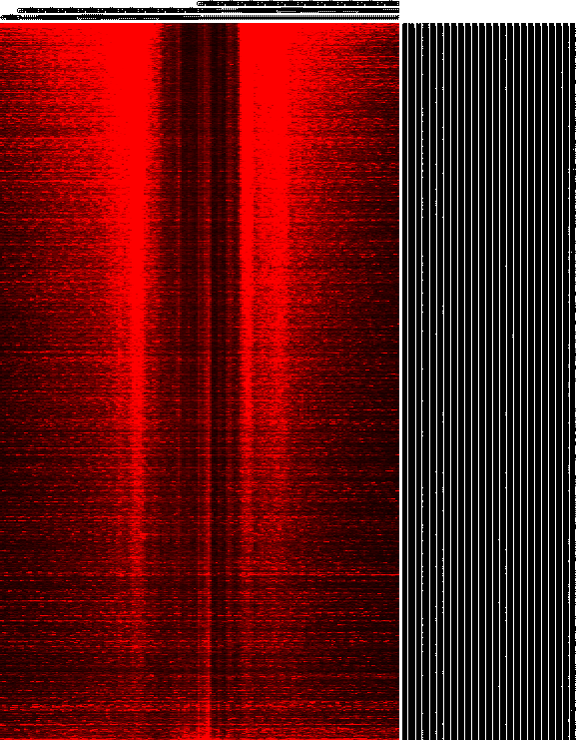
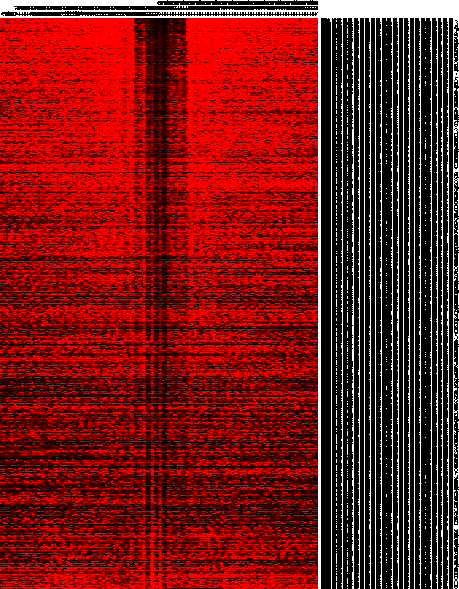
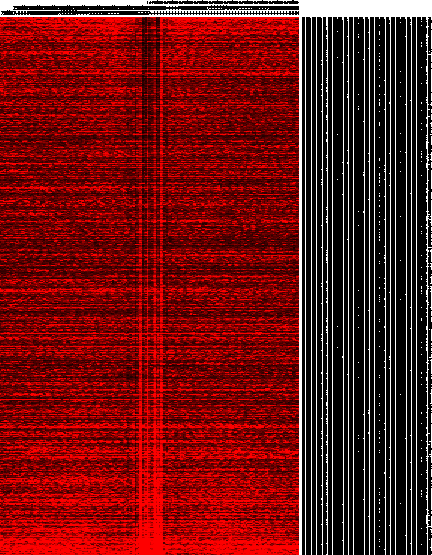
Nrf1
GR(NR3C1)
CTCF
Genomic locus (centered on motif)
ATAC edge
density
hi
lo
Notes:
Short residence TF (such as nuclear receptors GR AR ER)
Long residence TF (such as CTCF)

Slide 27
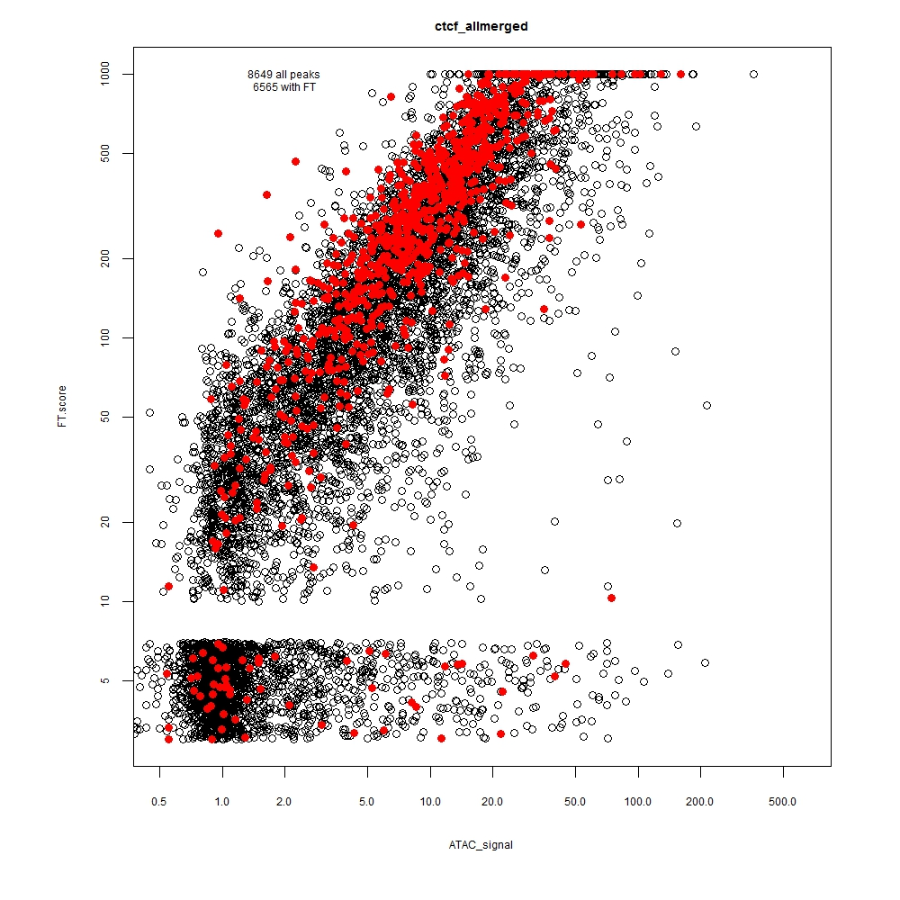
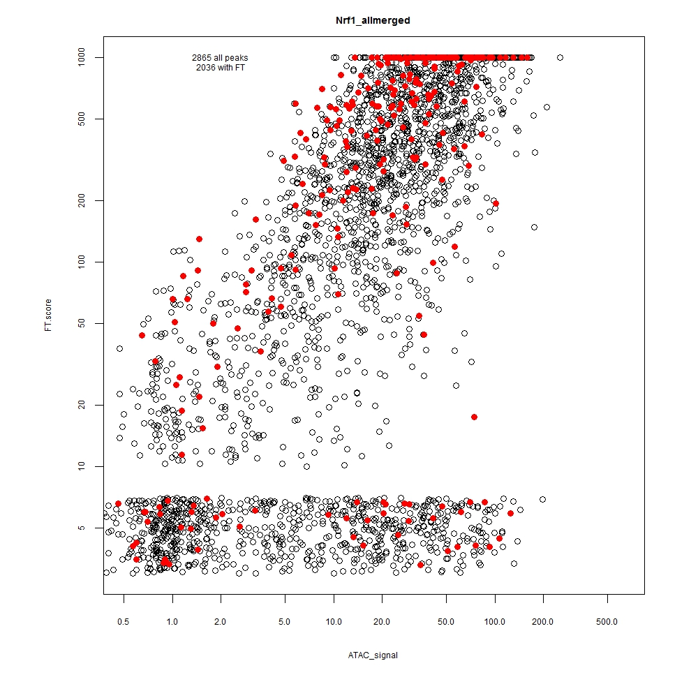
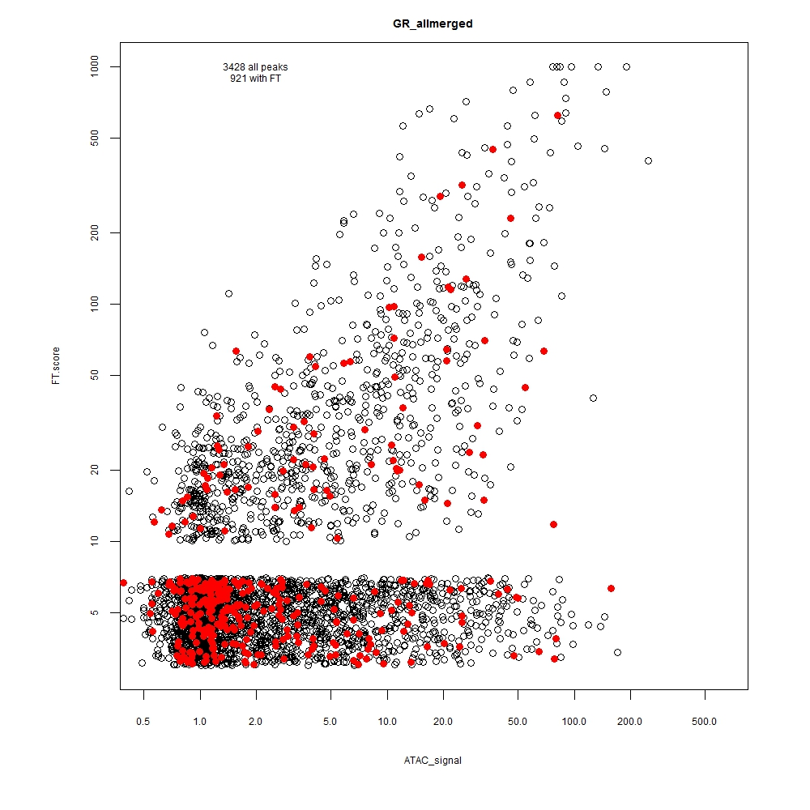
Footprint score and motif score
Red=peaks with highest motif score (top10%)
CtCf
Nrf1
GR
Footprint score
ATAC density

Slide 28
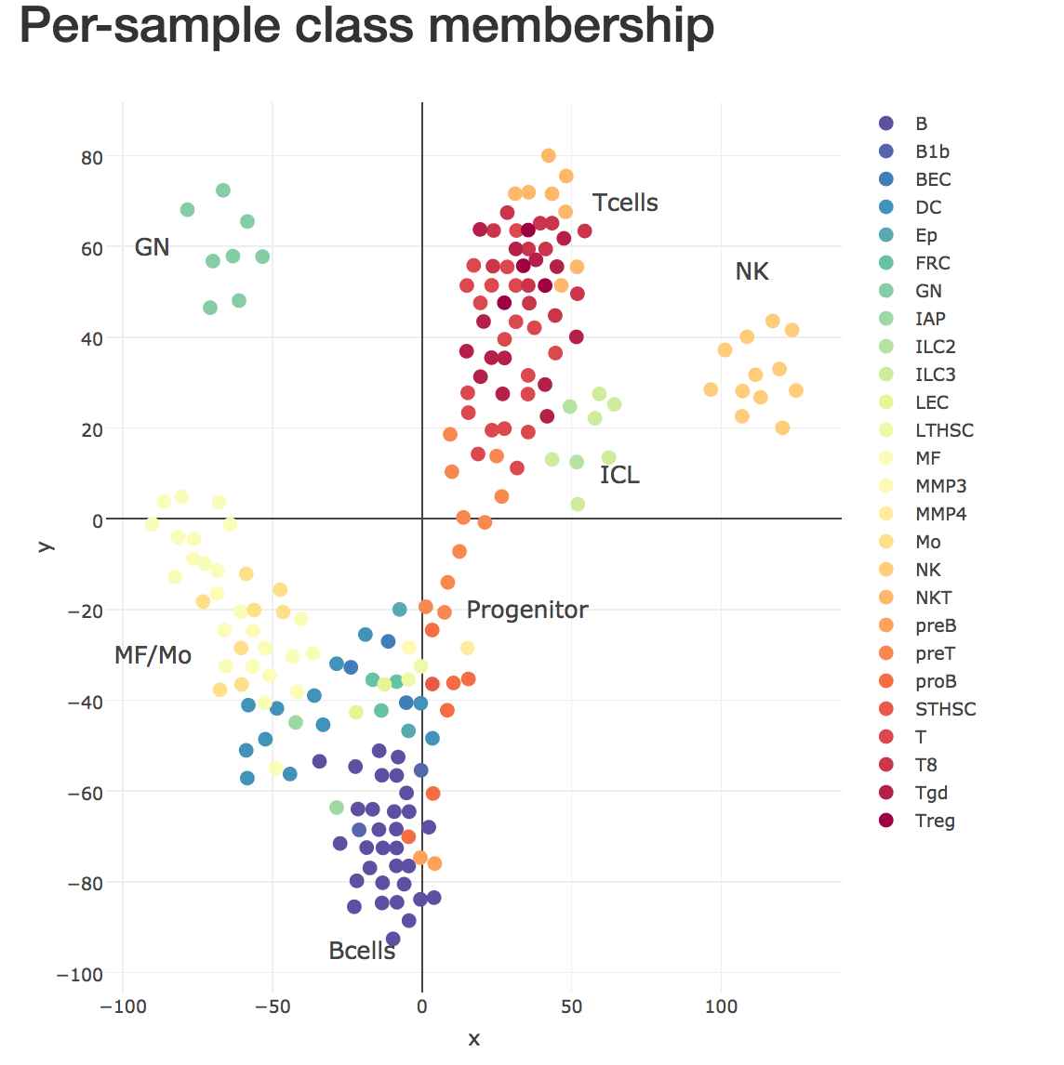

Slide 29
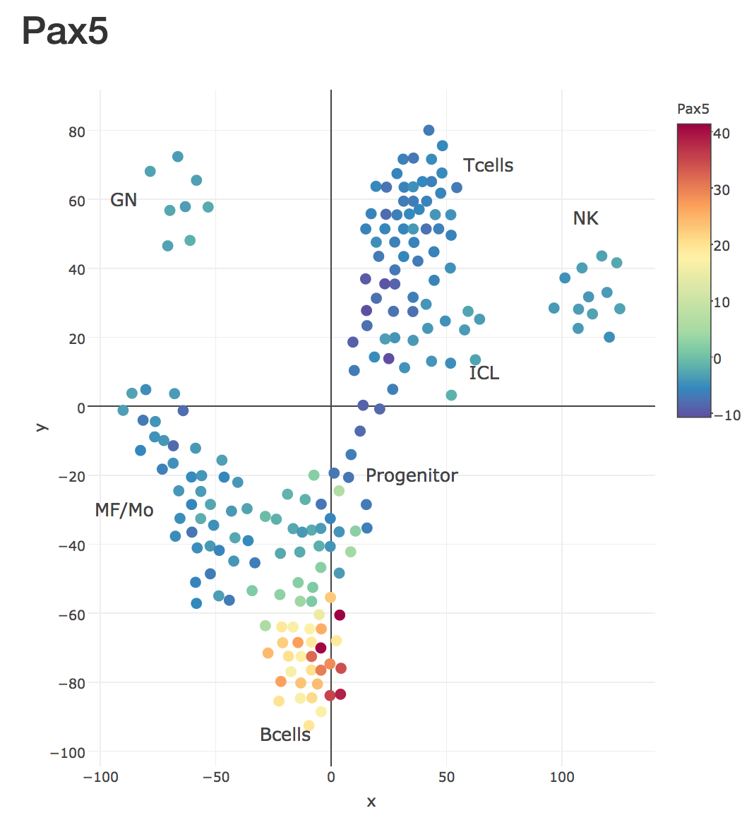
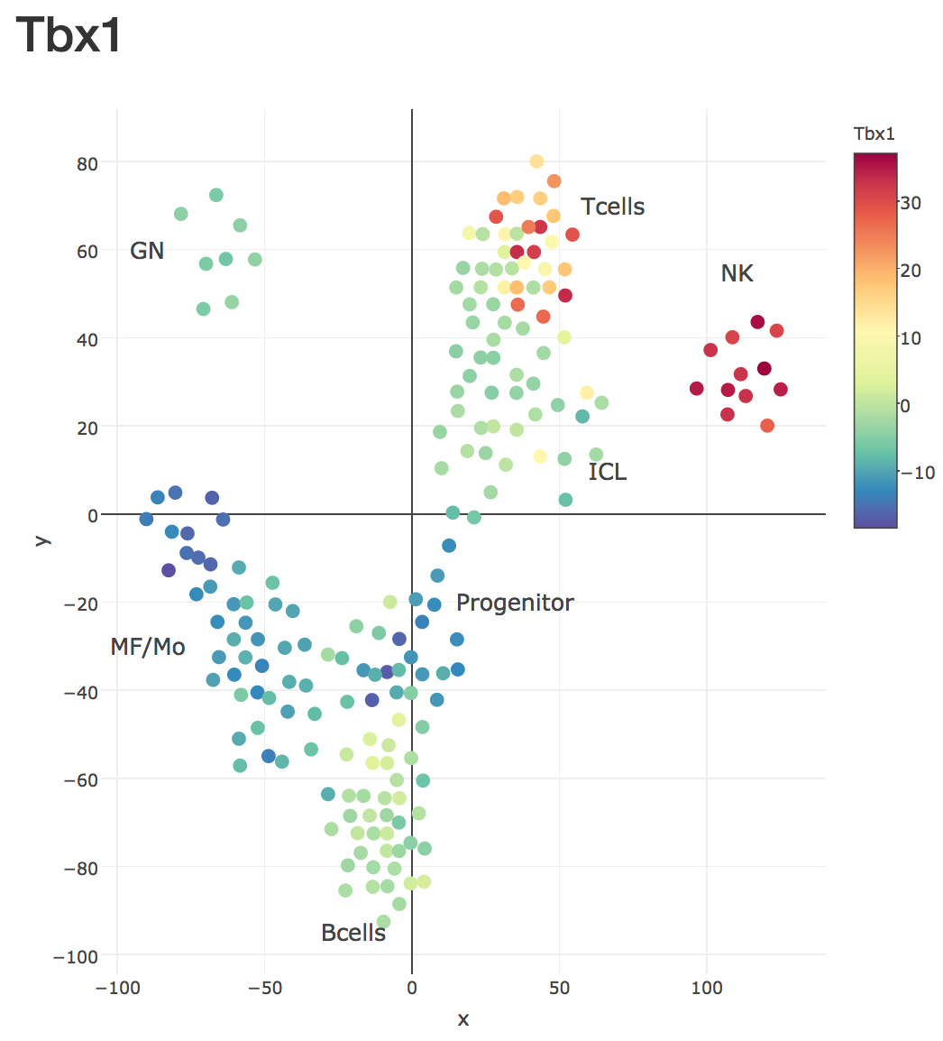

Slide 30
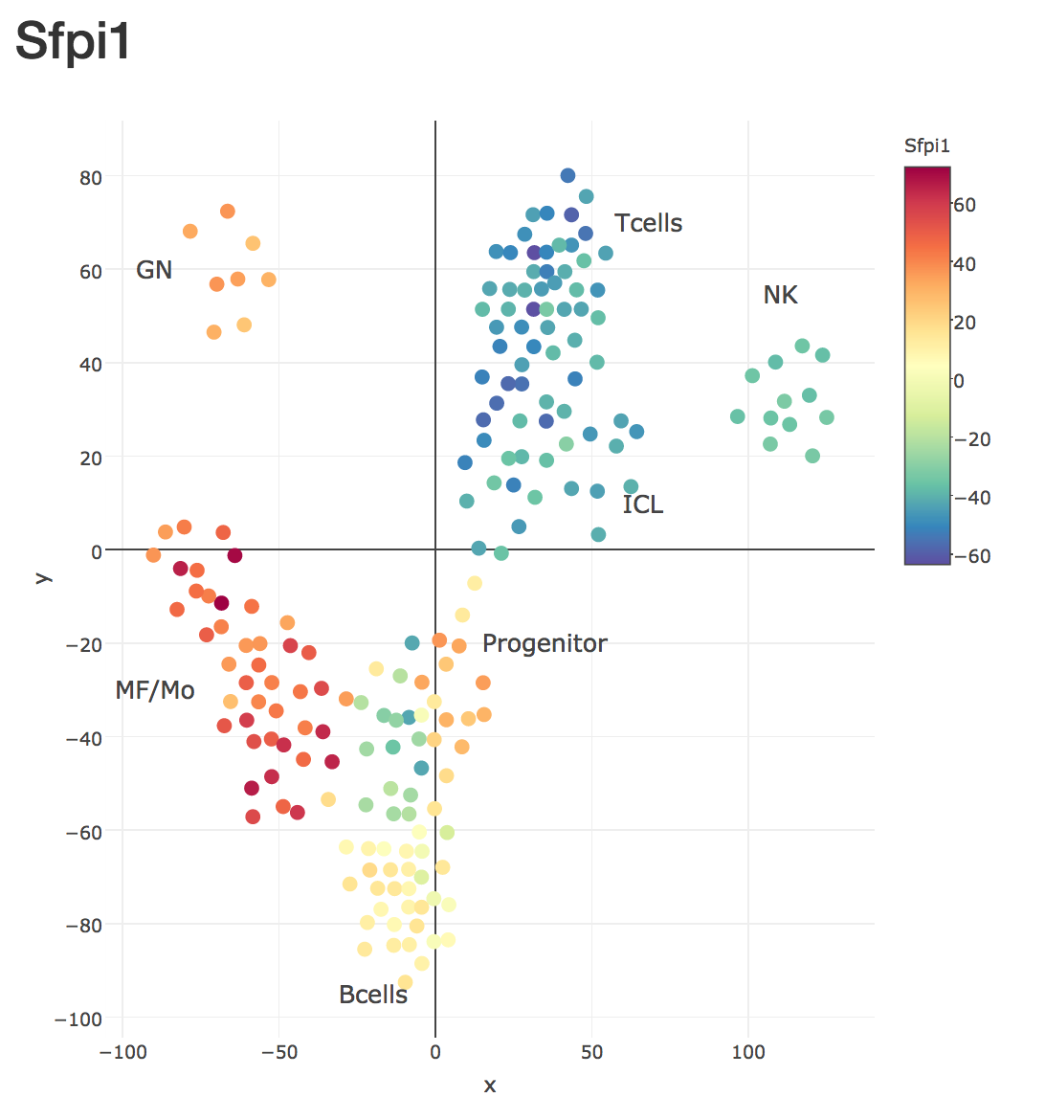
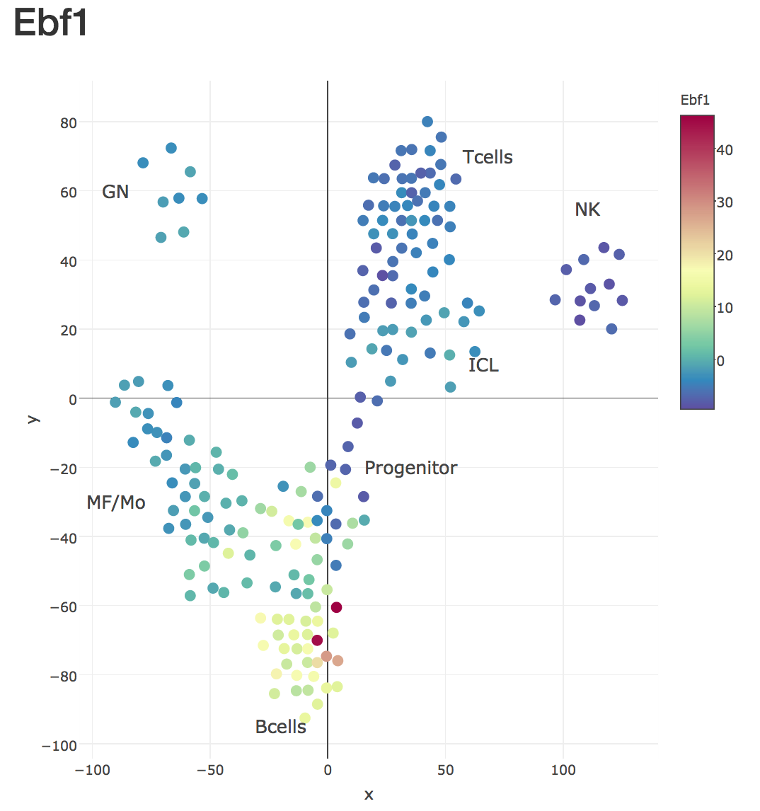

Slide 31
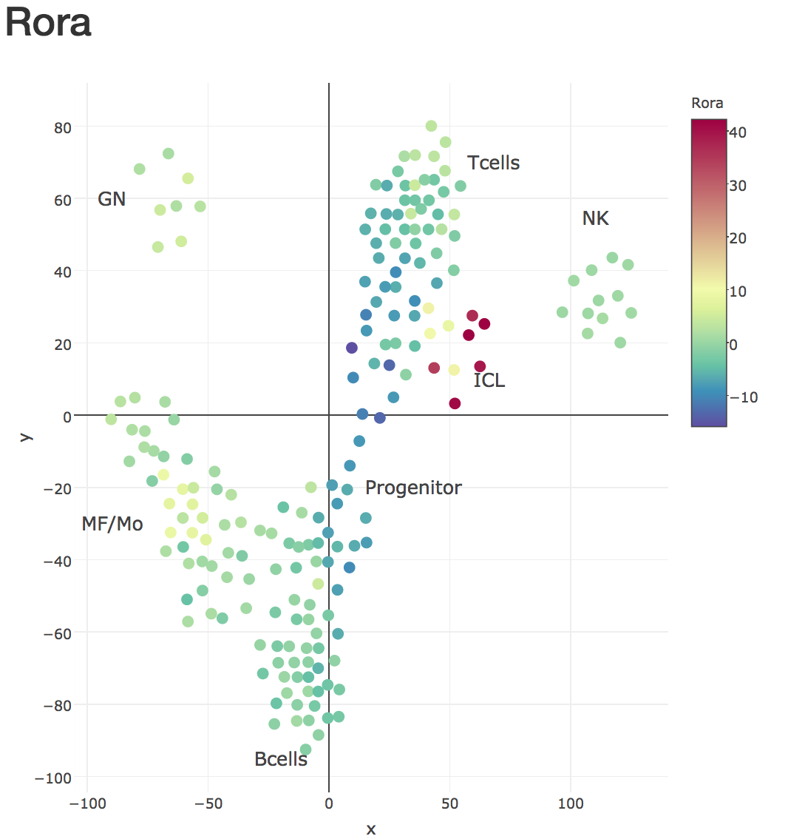

Slide 32
Acknowledgement
All ImmGen people, especially who isolated the cells!
(Thanks for following the strict SOP)
Corodinating, cell sorting etc.
A.Rhoads
Sequencing
M.Thorsen, T.Karanja and K.Waraska (Biopolymers Facility, HMS)
Data analysis
J.Buenrostro, C.Laplace and L.Yang

Slide 33
How do I access the data? (PIs have received this…)

Slide 34
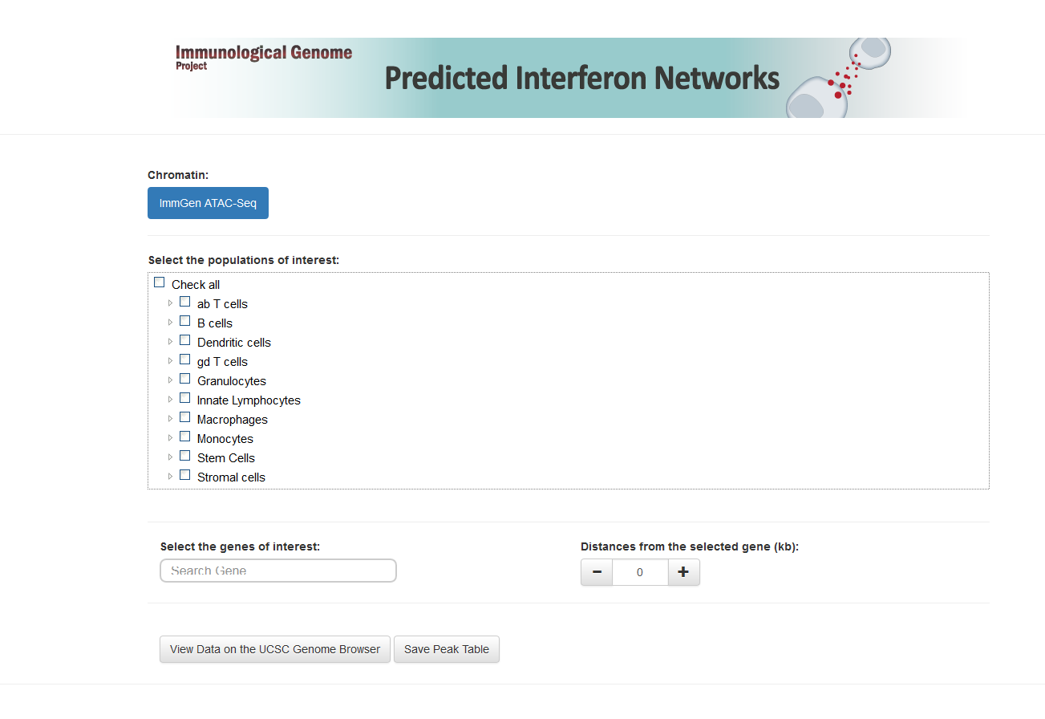
http://rstats.immgen.org/Chromatin/chromatin.html
1. Select population
2. Enter gene name

Slide 35
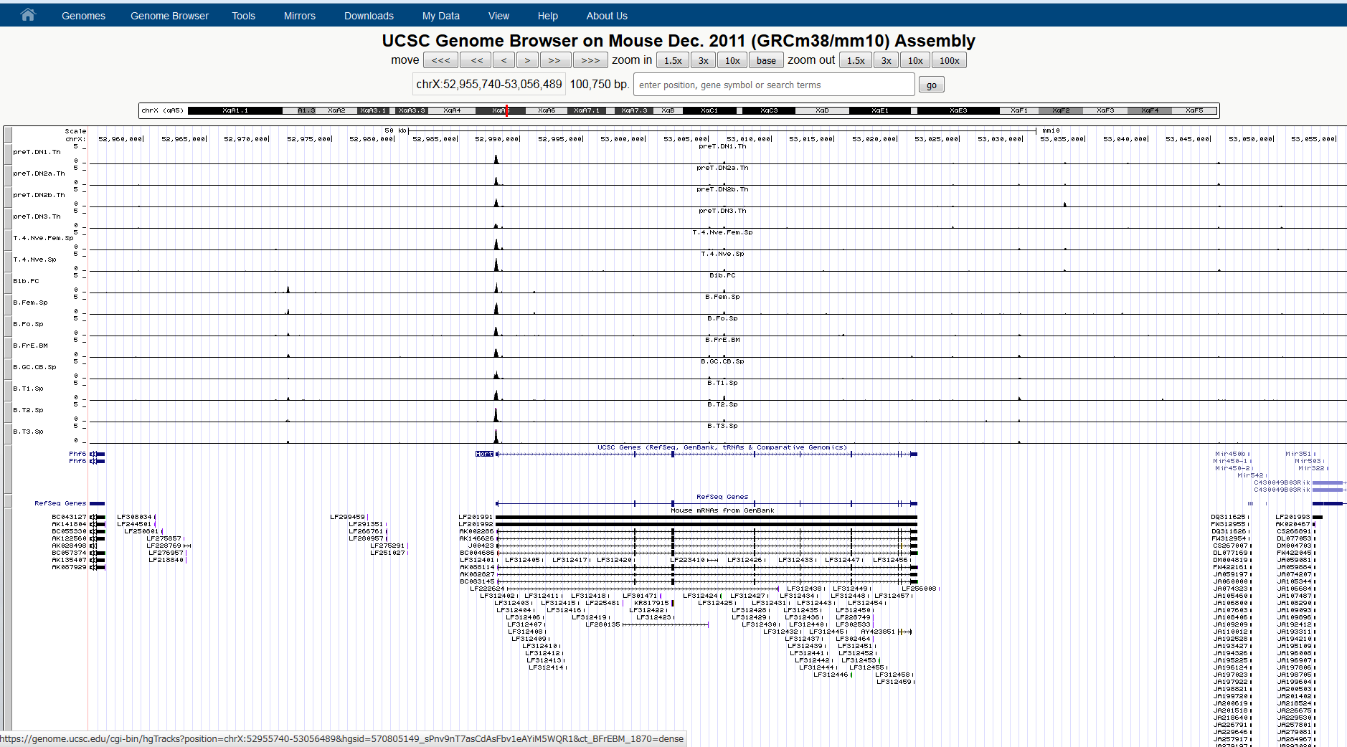
HPRT

Slide 36
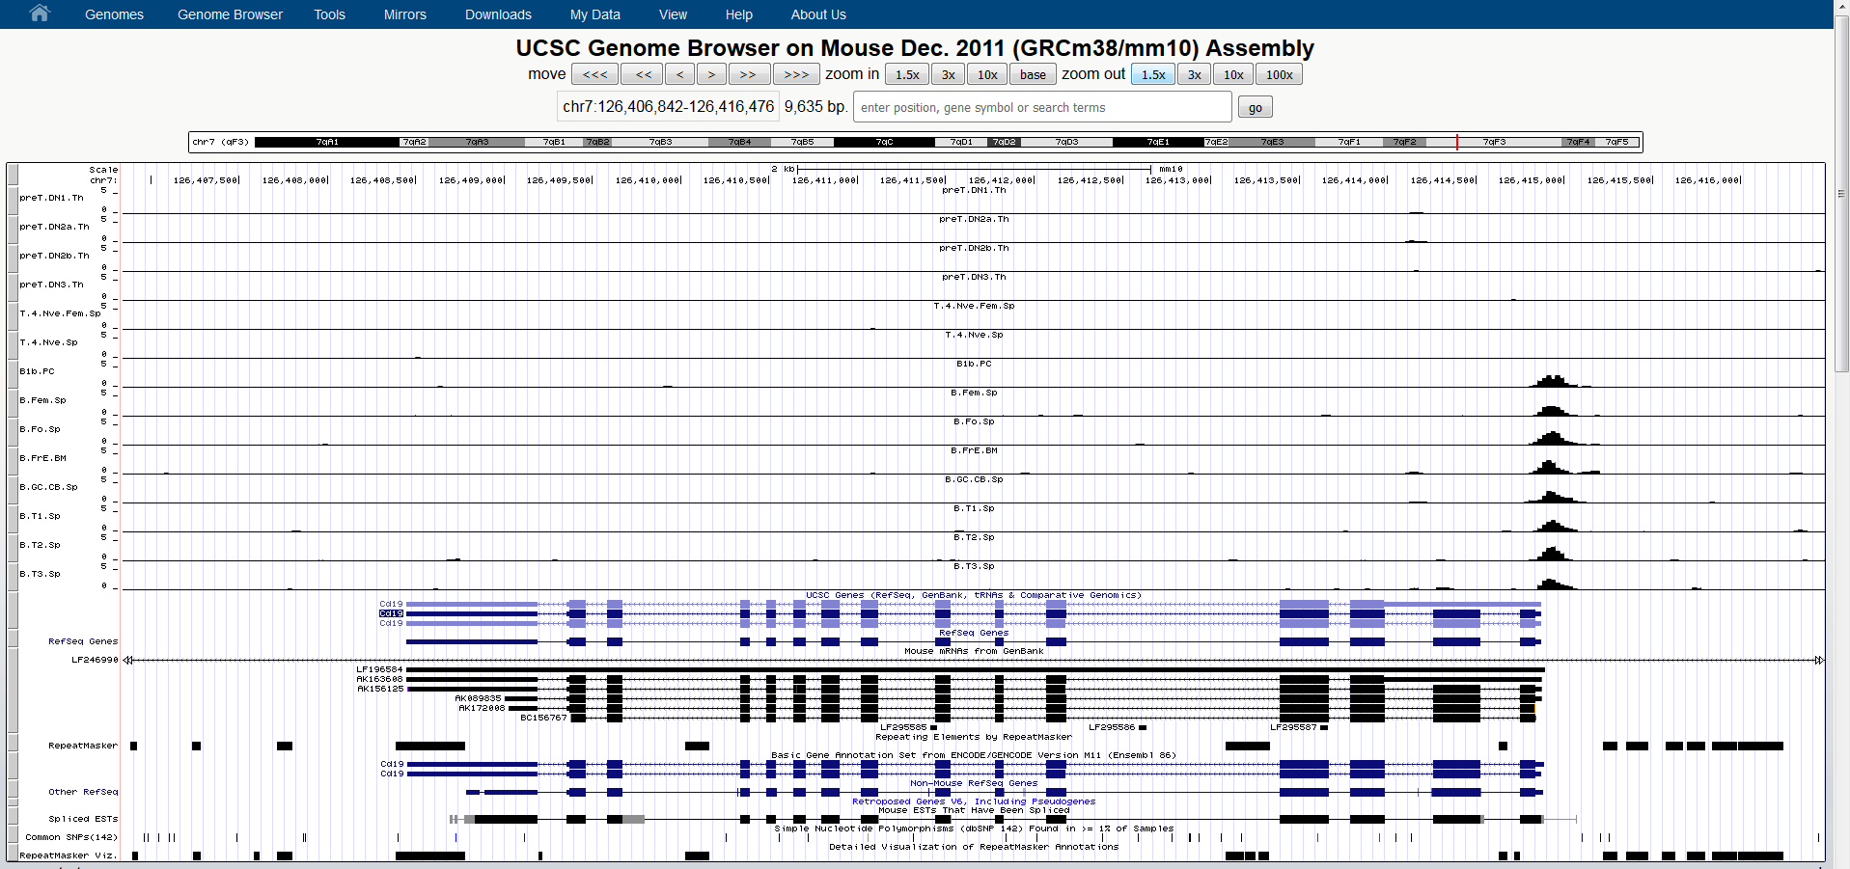
Auto-scaling in default
CD19

Slide 37


Needs more flexibility?
Data on Dropbox
https://www.dropbox.com/sh/6uqqftra4x9r0y3/AAA48oF_J5NZosGfL4plnwVNa?dl=0
.bam and .bai
To see the each fragments
2) .bw
To see the pile-up graph
These are mapped on mm10
IGV for visualization
http://software.broadinstitute.org/software/igv/
Package can be download from Broad website (64bit windows, Mac)
run on Java

Slide 38
Thanks!
buenrostrolab.com/ImmGenATAC

Slide 40
mapping ATAC to gene expression
Examples: Peaks associated with > 10 genes
Peak_444648
Log pvalue
Peak_85734
Log pvalue
Klrb1a | 22.2404 | -955589
Klrb1 | 15.7449 | -855477
Klrb1c | 11.1691 | -789882
Klre1 | 17.943 | 238
Klrk1 | 8.9528 | 44160
Klrc3 | 21.033 | 64765
Klrc2 | 22.1506 | 82033
Klrc1 | 8.5297 | 100450
Klri2 | 15.798 | 161961
Klra5 | 16.499 | 334701
Klra18 | 21.0574 | 488735
Klrb1f | 9.6529 | 532623
Klra8 | 9.6899 | 551312
Klra14-ps | 21.8615 | 582225
Klra9 | 21.0222 | 614589
Klra7 | 21.926 | 653164
Klra10 | 22.6836 | 703405
Klra12 | 8.9294 | 727958
Klra23 | 22.4528 | 729838
Klra3 | 19.1539 | 759103
Klra22 | 14.1078 | 802285
Klra1 | 14.0033 | 808351
Kif1c | 3.8714 | -819678
4930544D05Rik | 3.3872 | -735024
Pld2 | 4.4285 | -659402
Dnah2 | 3.2681 | -331761
Cd68 | 4.2038 | -214699
Tnfsf13 | 2.8314 | -195315
Tnfsf12 | 5.8271 | -184771
Gabarap | 11.593 | -110500
Kctd11 | 9.8103 | 116
Rnasek | 7.7121 | 358983
Trappc1 | 2.694 | 556884
Cxcl16 | 2.8203 | 579115
Chrne | 3.49 | 738325
Per1 | 3.2197 | 780712
Camta2 | 7.3821 | 807236
Scimp | 3.6242 | 931692
Not detecting huge super enhancers??
SM

Slide 41
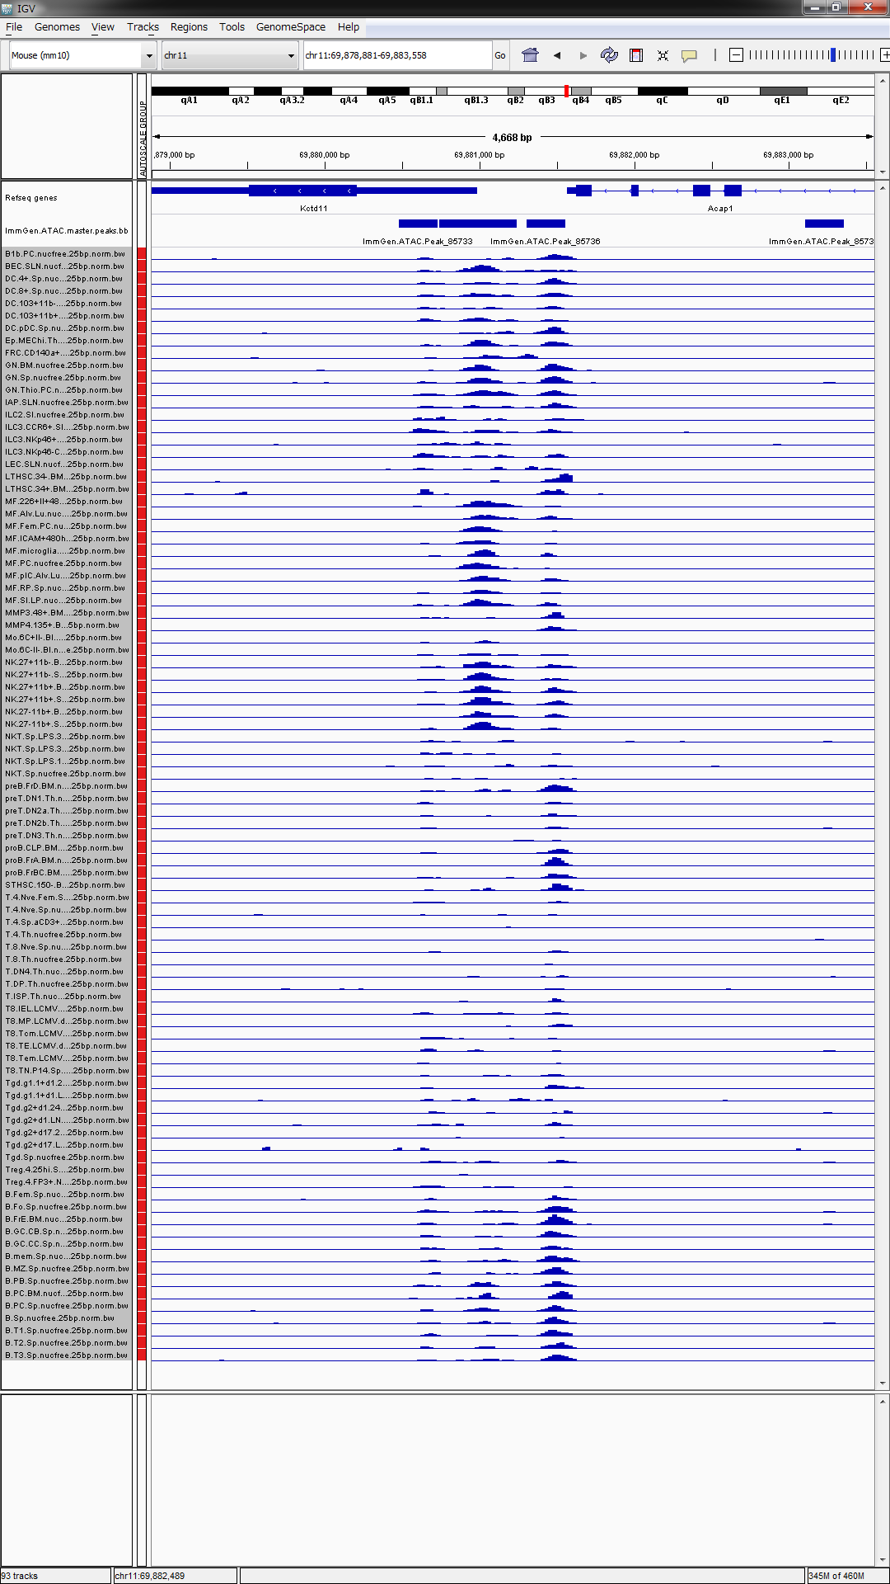
Examples: Peaks associated with > 10 genes
Kctd11
Peak_85734
Log pvalue
Distance
Kif1c | 3.8714 | -819678
4930544D05Rik | 3.3872 | -735024
Pld2 | 4.4285 | -659402
Dnah2 | 3.2681 | -331761
Cd68 | 4.2038 | -214699
Tnfsf13 | 2.8314 | -195315
Tnfsf12 | 5.8271 | -184771
Gabarap | 11.593 | -110500
Kctd11 | 9.8103 | 116
Rnasek | 7.7121 | 358983
Trappc1 | 2.694 | 556884
Cxcl16 | 2.8203 | 579115
Chrne | 3.49 | 738325
Per1 | 3.2197 | 780712
Camta2 | 7.3821 | 807236
Scimp | 3.6242 | 931692
Notes:
Kctd11
Plays a role as a marker and a regulator of neuronal differentiation; Up-regulated by a variety of neurogenic signals, such as retinoic acid, epidermal growth factor/EGF and NGFB/nerve growth factor. Induces apoptosis, growth arrest and the expression of cyclin-dependent kinase inhibitor CDKN1B. Plays a role as a tumor repressor and inhibits cell growth and tumorigenicity of medulloblastoma (MDB). Acts as an E3 ubiquitin-protein ligase towards HDAC1, leading to its proteasomal degradation. Functions as antagonist of the Hedgehog pathway on cell proliferation and differentiation by affecting the nuclear transfer of transcrition factor GLI1, thus maintaining cerebellar granule cells in undifferentiated state, this effect probably occurs via HDAC1 down-regulation, keeping GLI1 acetylated and inactive. When knock-down, Hedgehog antagonism is impaired and proliferation of granule cells is sustained. Activates the caspase cascade.

